Slide 1

MMORPG

Slide 2
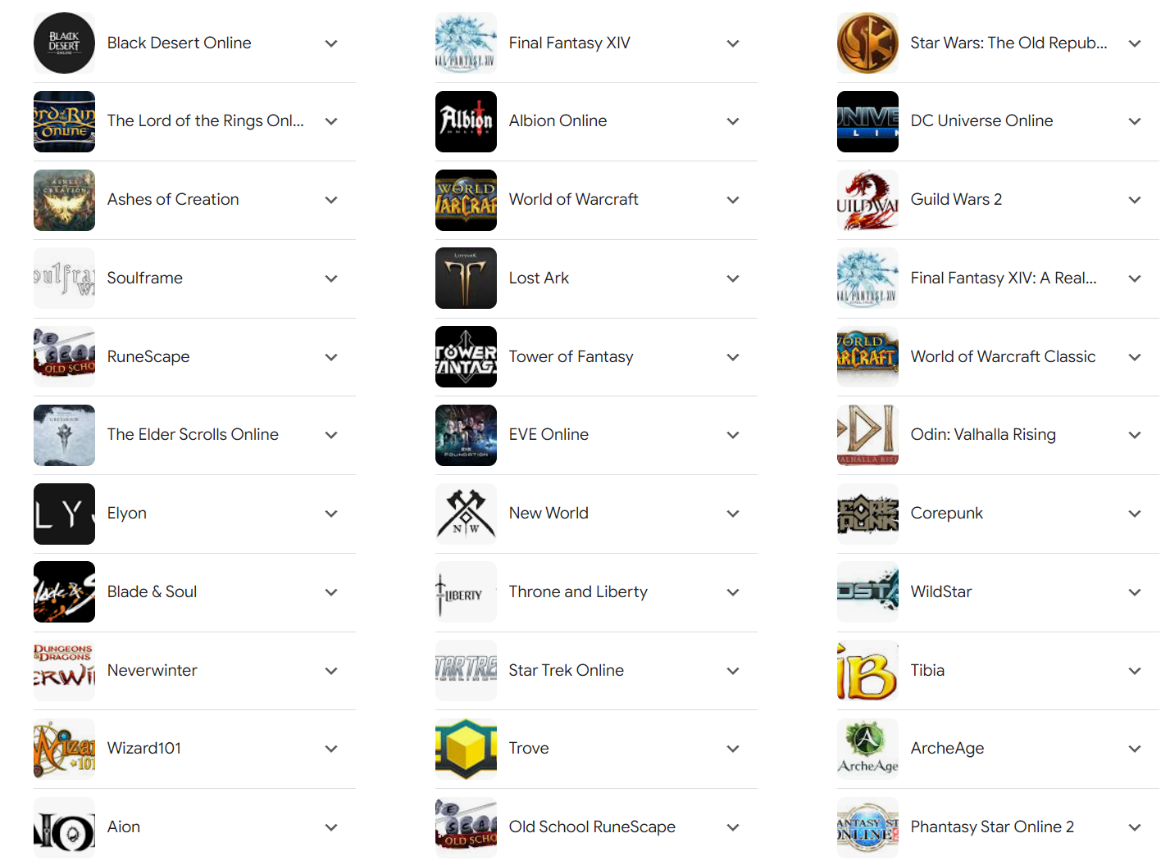
01
Definition
A massively multiplayer online role-playing game (MMORPG) is a video game that combines aspects of a role-playing video game and a massively multiplayer online game.

Slide 3
01
The terms I use
Freeloader(白嫖党): Players who spend no money in F2P games.
Reasonist(微氪): Players who spend a little bit of money in games to get a better experience, for instance having a subscription card.
squanderer(氪佬): Players who maximize their characters’ power no matter how much they cost.

Slide 4
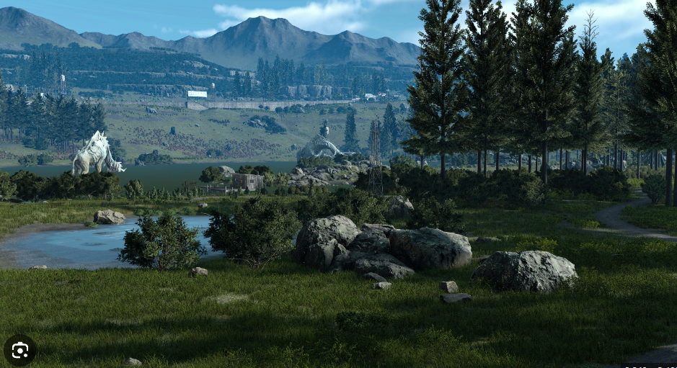
02
Role-playing game
Role-playing game is not simply a genre in which players project themselves into characters in the world.
A level system and various skills and actions embedded in it are essential to Role-playing games.
Nobody wants to wander in an empty beautiful world.

Slide 5
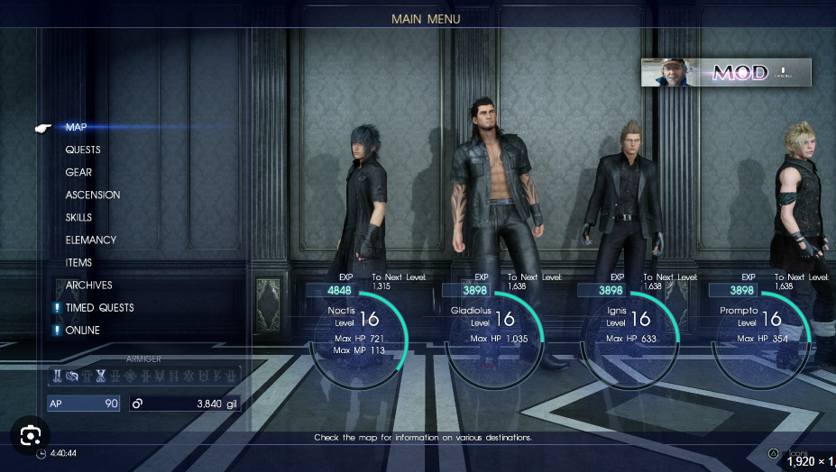
02
Role-playing game
Players are motivated not only by a compelling story but also by a well-crafted level system.
Keeping the game balanced is always most important in single-player games while disrupting balance is the key to making money from a MMORPG.

Slide 6
03
Power inflation
It’s imbalanced from the beginning of an MMORPG, players who invest massive money are much more powerful than those who spend less or no money.
The nature of MMORPG gameplay is to get stronger and stronger. Each version updates new characters, weapons, items, and so on. Those all need more money to maintain relative power.

Slide 7
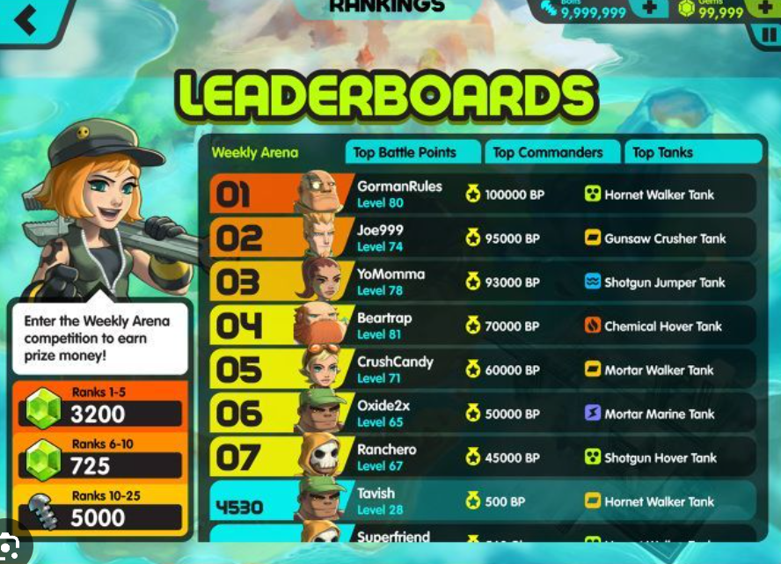
03
Power inflation
In single-player RPG games, power is absolute, players are stronger and better than before.
While in MMORPG games power is relative, even it’s true that a player is stronger than himself in the last version, compared to other players, he could be frustrated.

Slide 8
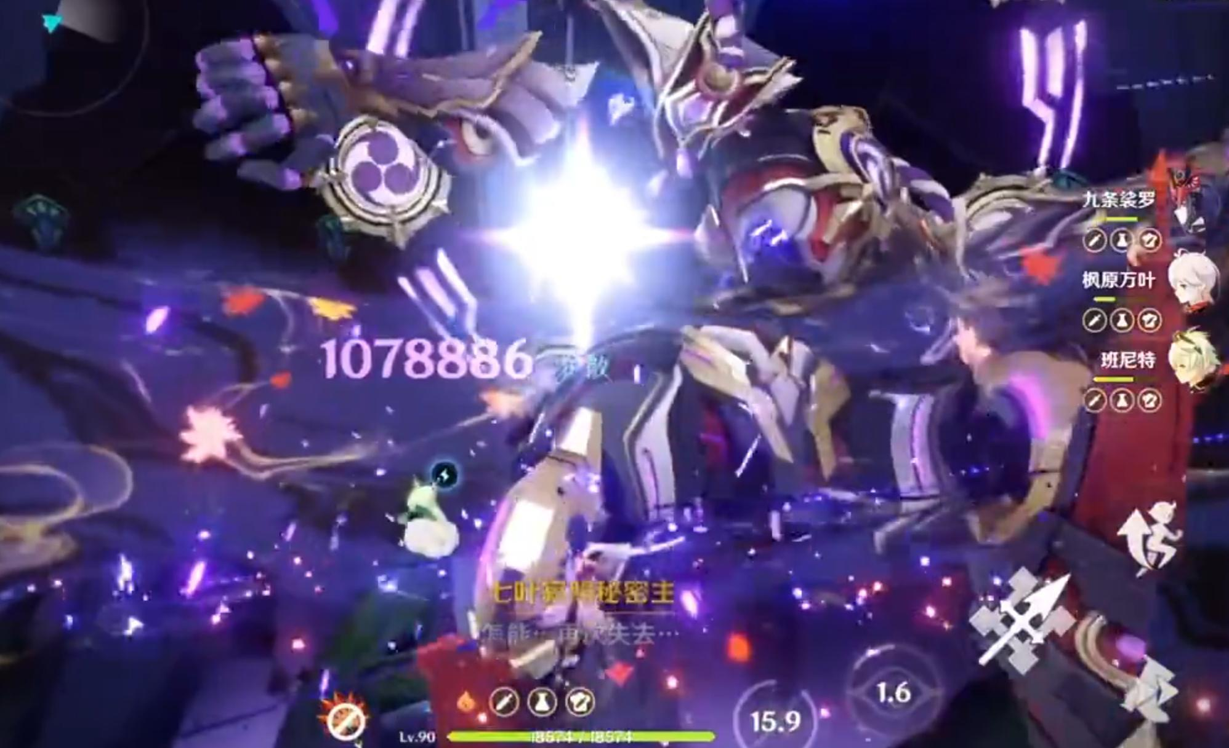
03
Power inflation
At first, players who spend less or no money deal normal damage to enemies, while squanderers instant kill enemies.
As versions are updated, freeloaders who play every day can also instant kill enemies, consequently the combat system design is meaningless.

Slide 9
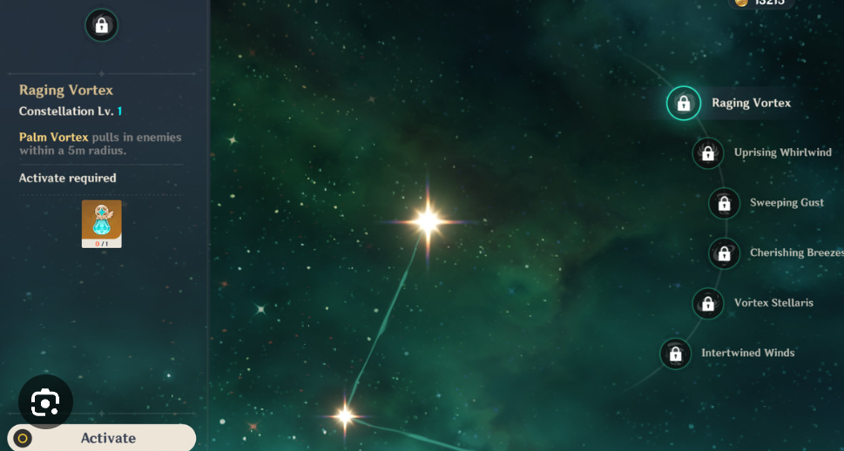
04
Monetized Gameplay Systems
Systems that treat players as financial data
Take Genshin Impact as an example - In Genshin Impact all systems are Monetized, such as level system, characters, and weapons.
Players need to spend real money to unlock characters’ abilities and get exclusive weapons for characters.

Slide 10
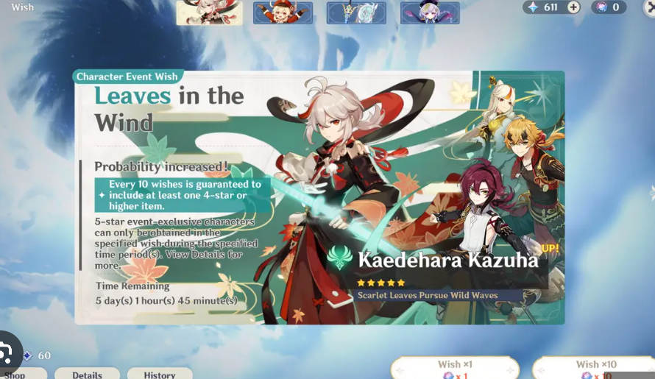
05
Gamblized Gameplay Systems
Systems that manipulate players desire
Instead of pricing the items, it’s more addictive to mire players into gambling. Players are more willing to spend money on a gamblized game even though the price of an item is the same.
Each draw will produce an illusion that makes players think they are lucky enough to win the jackpot(in Genshin Impact is five star character and weapon).

Slide 11
Which game’s mode do you prefer, pay to play or free-to-play?

Slide 12
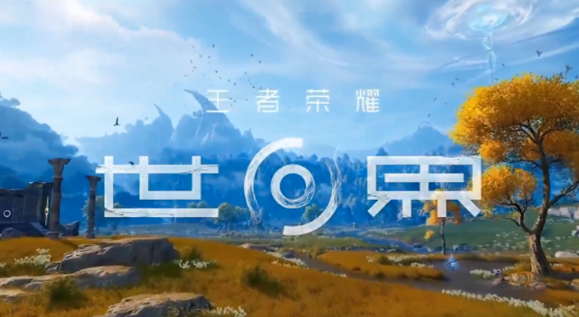
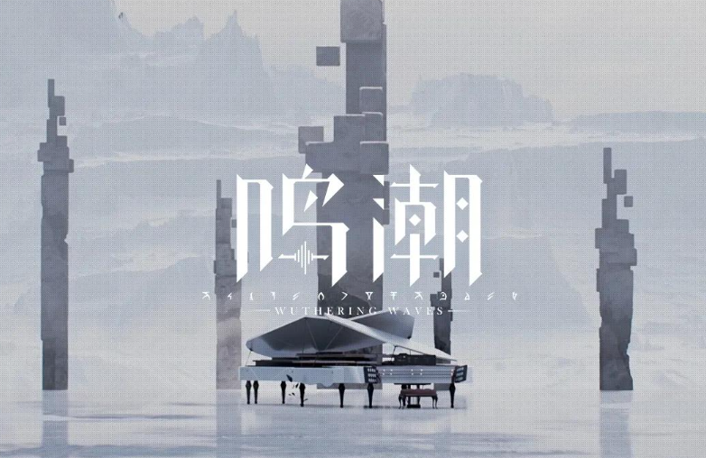

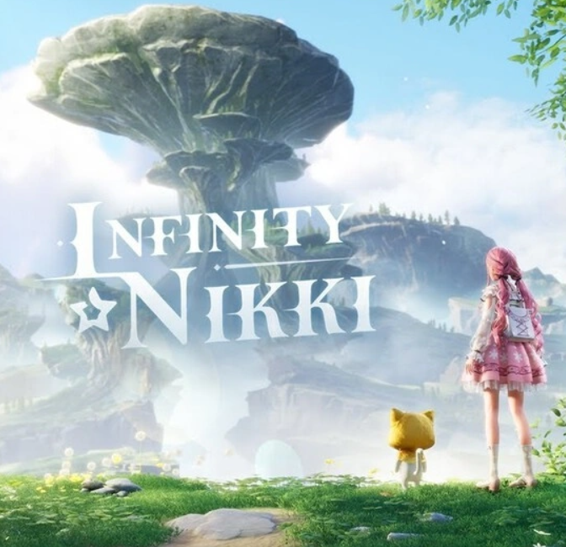
06
The rerising the MMORPG
MMORPG seems to dying in when the debut of smartphones, players changed to a more casual mobile platform.
However since the performance of smartphones is more and more powerful. More and more producers are planning to develop MMORPG games due to the great success of Genshin Impact.

Slide 13
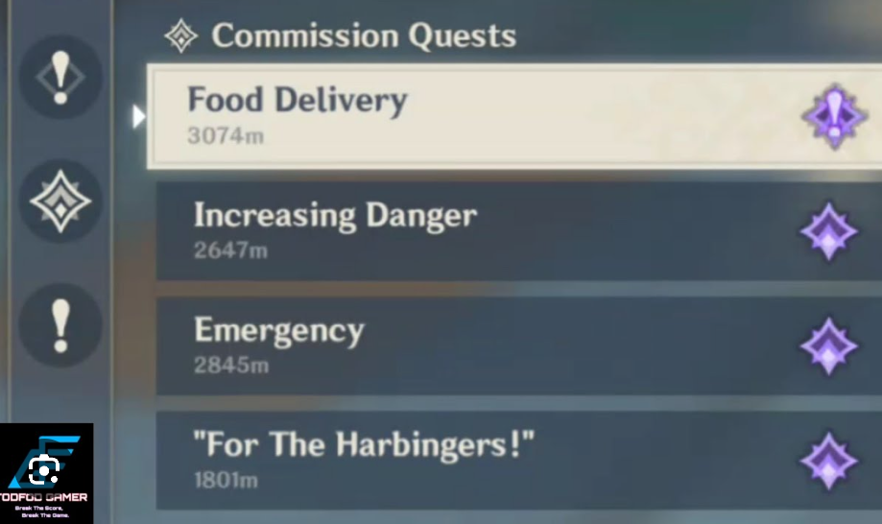
07
Why I dislike online games.
The gameplay systems of online games are monetized, massive money is needed to have the equal experience of single player games.
Online games always force me to compare with other players and to spend money to be better than others.
Online games are repetitive in the late of games,
even in MMORPG games in which more rich content and gameplay systems they have.

Slide 14

08
Pareto's law in online games
In a F2P game, usually 20%(even less) of squanderers contributes 80%(even more) revenue, while 80% of freeloaders and reasonists are stingy.
F2P games are designed to squash every coin from Players, they are designed to make different levels of players spend money that corresponds to their levels.
In other words, F2P game is a mirror of reality, a financial game in which players are data of it.
When come across something you like, buy it, the money is not really spent, but in another form of company you.

